Slide 1
Ray Framework
ECE – 718
By: Om Tank

Slide 2
Ray : Introduction
Powerful open-source and Distributed computing framework.
Majorly built for the Python data science community.
Run and tested locally on a cluster practically without any changes.
Leading industry players including Uber, Netflix, Instacart, and Airbnb uses Ray as an abstraction layer over their AI infrastructure.
Simplifies scaling compute-intensive Python workloads, making it easier to structure and run machine learning programs at bigger scale.

Slide 3
History of Ray:
Researchers Philipp Moritz and Robert Nishihara at RISELab in UC Berkeley created Ray
Efficient ways to speed up their workloads by distributing workloads
Researchers should be able to focus on their work, regardless of the specifics of their compute cluster
For this reason, Ray was built with an emphasis on high-performance and heterogeneous workloads

Slide 4
Key Points for implementing Ray:
Ease of use
Scalability
Flexibility
Comprehensive Toolset
Ecosystem Integration

Slide 5
Design Principles of Ray:
Simplicity & Abstraction
Flexibility & Heterogeneity
Speed & Scalability
Fault Tolerance

Slide 6
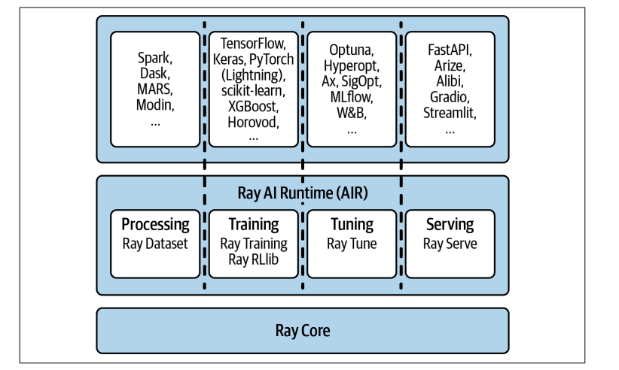
Ray (3 Layer Model) 1. Core 2. Libraries 3. Ecosystem

Slide 7
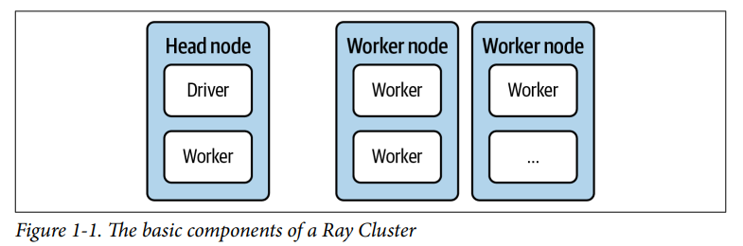
Components of Ray Cluster:

Slide 8
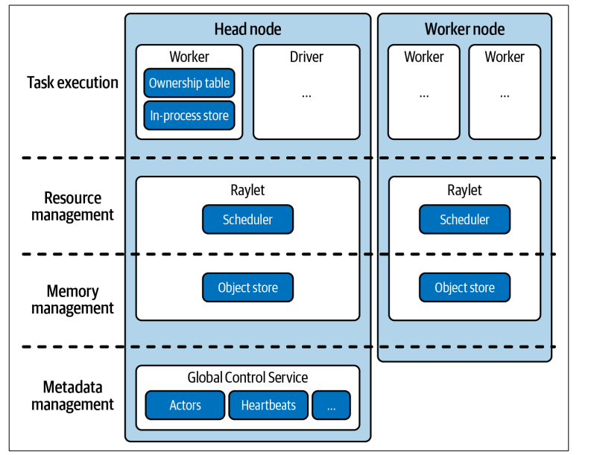
Ray Architecture:

Slide 9
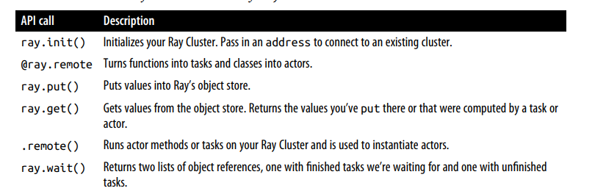
Ray Core APIs:

Slide 10
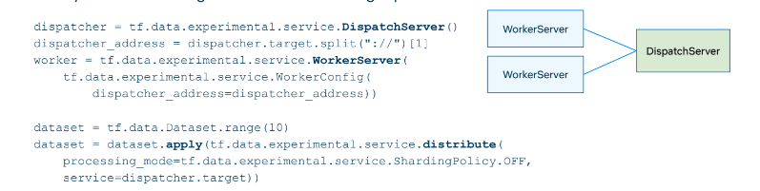
Real Time Example – Netflix
At Netflix, everything is a recommendation from artwork to present, showing the related content and titles recommendation.
Netflix uses Ray framework for distributed data loading service and heterogenous training of clusters.
For distributed data loading services, Netflix uses tf.data.experimental.service and tensorflow-dataservice as an example.

Slide 11
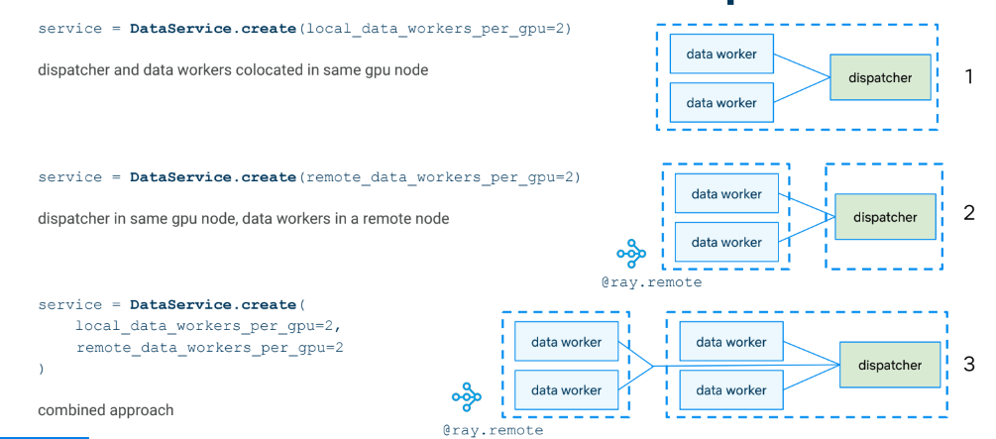

Slide 12

Demo Code – MapReduce Word Count Example

Slide 13
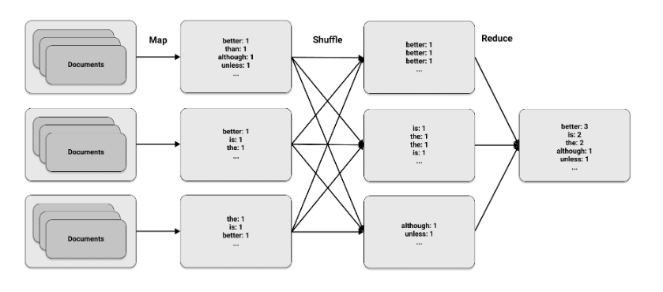
MapReduce is a significant development in distributed computing in recent decades.
Many popular big data technologies, such as Hadoop, are built upon this programming model.
The approach involves three simple steps:
Map
Shuffle
Reduce

Slide 14
